Slide 1

OPEN
DATA
SCIENCE
CONFERENCE
@ODSC

Slide 2
Improving Data Quality for Superior Results
April 30, 2019 | 5:00pm - 5:30pm | Open Data Science Conference

Slide 3


Slide 4




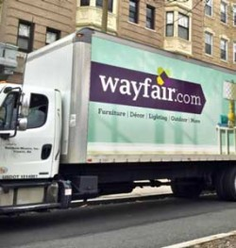
About Me
High School History Teacher
Energy Efficiency Program Evaluation
Grocery Analytics
Business Intelligence & Supply Chain

Slide 5
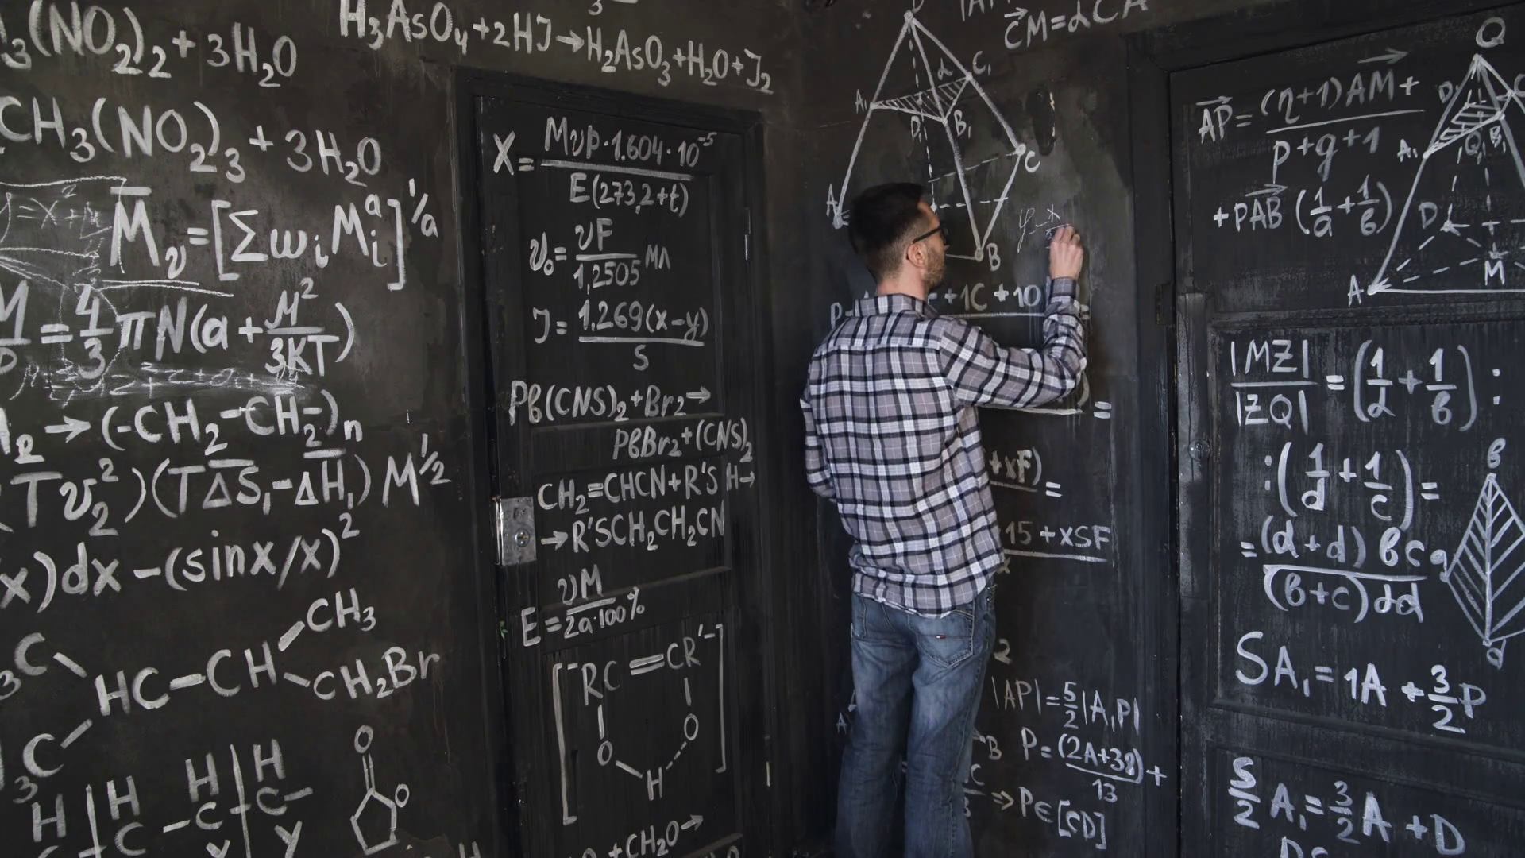
Tackling the Right Problem

Slide 6


Junk In, Junk Out
Notes:
If there is random noise in your inputs, there will be random noise in your model
If the error is not random - you can do some things to control for that. But that is a seperate talk

Slide 7
Two Wayfair Examples
Capacity Dashboards
International Supply Chain “Issues” Dashboard

Slide 8
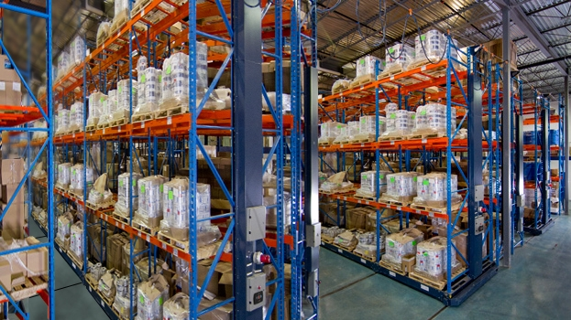
WH Capacity
Business Problem: No source of truth for how many cubic feet constitutes a full warehouse

Slide 9
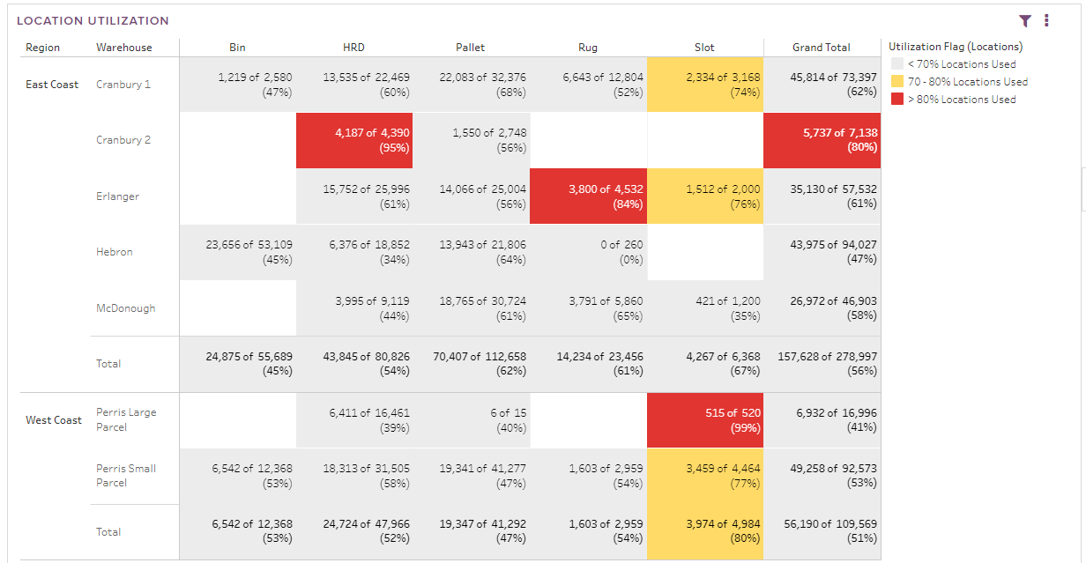
WH Capacity
Solution: Automated Reporting that anyone can check to see how full we are this week, and in the past

Slide 10
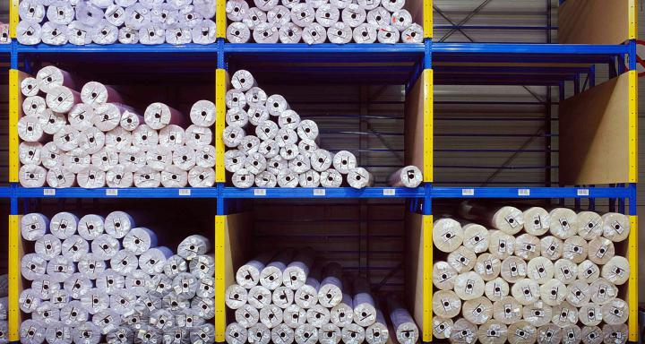
WH Capacity
How:
Found a champion
ID the cause of the data issue
Transparent about the solution
Sometimes the best way to get an answer is to put out the wrong answer and see what happens
Continued automated Reporting

Slide 11
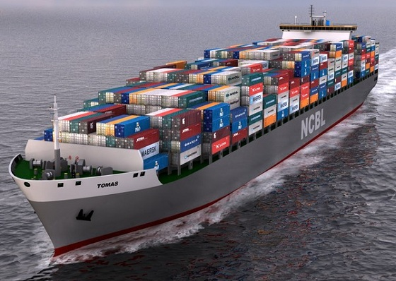
Ocean & Dray Data Issues Dashboard
Notes:
New Area of the Business
When I joined, we literally could not figure out how many containers we had shipped last month.
Incurring charges because we were leaving containers at the port, we weren’t moving empty containers back to the port in time, we couldn’t close our financial books
Data entered manually

Slide 12
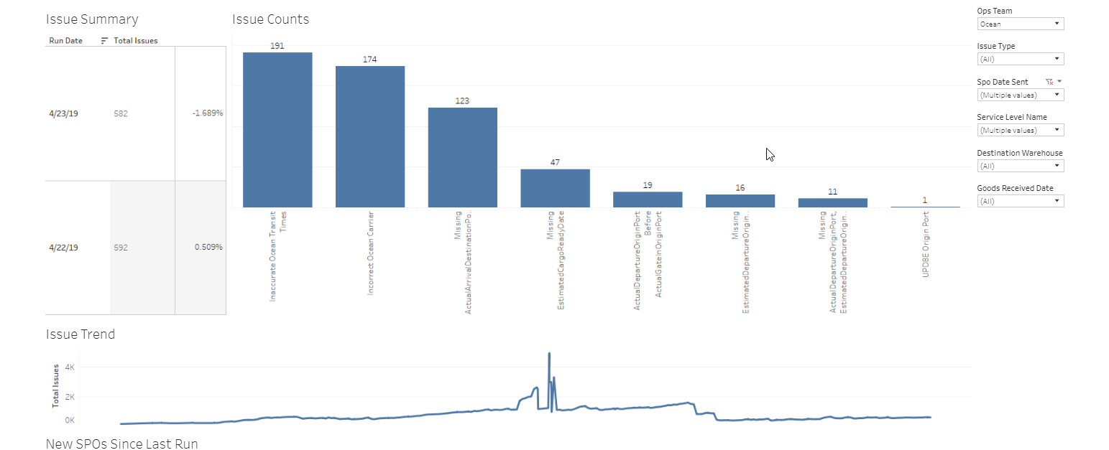
Ocean Supplier Issues Dashboard

Slide 13
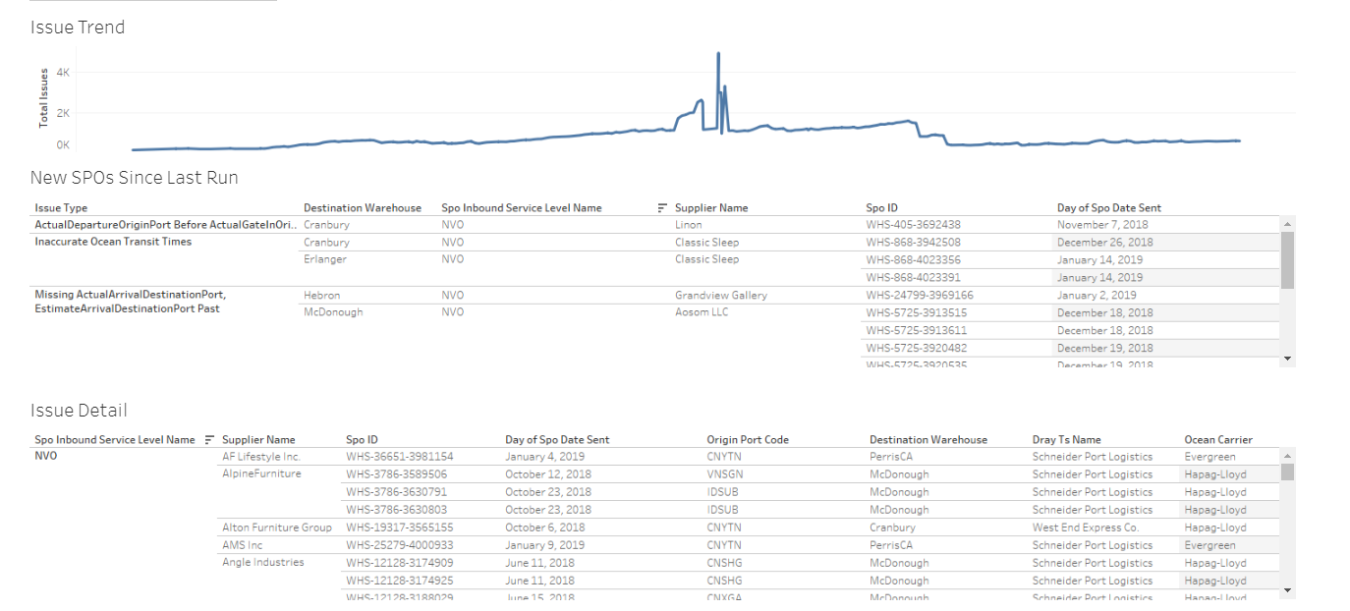
Ocean Supplier Issues Dashboard

Slide 14
Ocean Supplier Issues Dashboard
How:
Found a champion
ID the causes of data issues
Minimize manual data entry
Override Each Others Data
Same column for two different meanings
Similar columns from multiple data sources
Allow for self service QA of inaccurate data
Close partnerships with several stakeholders
Continued automated reporting

Slide 15


Kaitlin Andryauskas
Manager, Business Intelligence
kandryauskas@wayfair.com
https://www.linkedin.com/in/kaitlinandryauskas/

